Slide 1
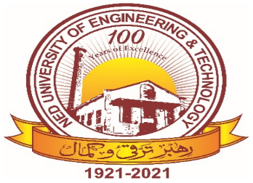

Introduction to Software Lecture 5 : week 11
Credit : (02) / Week

Slide 2
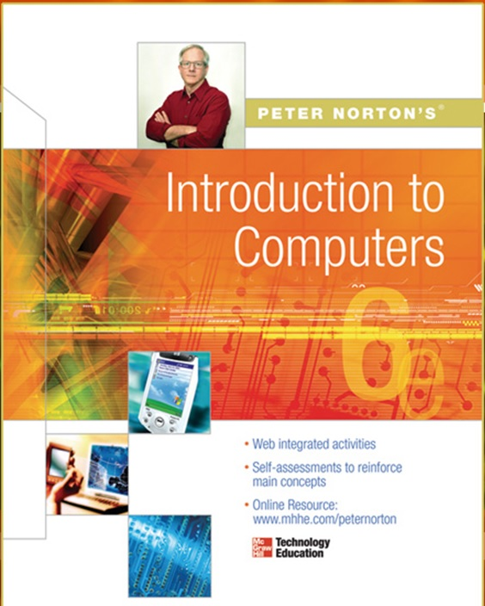
TEXT AND REF. BOOKS
Text Book:
Peter Norton (2011), Introduction to Computers, 7 /e, McGraw-Hill
Reference Book:
Gary B (2012), Discovering Computers, 1/e, South Western
Deborah (2013), Understanding Computers, 14/e, Cengage Learning
June P & Dan O (2014), New Perspective on Computer, 16/e

Slide 3

MOBILE ALERT
Kindly Switch Off your Mobile/Cell Phone
OR
Switch it to Silent Mode Please

Slide 4
Presented by: Simra Najm
Working with Software
system software & application software
Designation: Assistant Professor
Email: simranajm@neduet.edu.pk

Slide 5

Learning Outcome
What is Software
Software Types
System Software
Application Software (Word processor, Spreadsheets, Presentation etc)
Open Source Software
Proprietary Software
Utility Software
Malicious Software
Acquiring a Software

Slide 6
What is a Software ?
Computer software, or simply software is any set of machine-readable instructions that directs a computer's processor to perform specific operations.
Software tells the computer what to do and how to do.

Slide 7
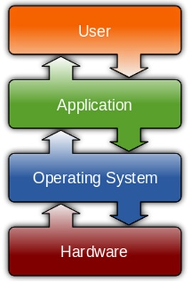
Types of Software
System Software
Application Software
Open Source Software
Proprietary Software
Malicious Software

Slide 8
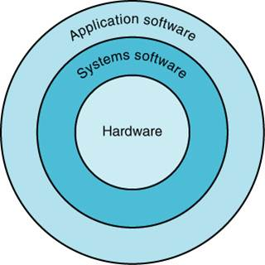
System Software
A program or set of programs that is especially designed to control different operations of computer system is called system software. It controls the working of different components of the computer.

Slide 9
System Software
System software is computer software designed to operate and control the computer hardware and to provide a platform for running application software
System software can be separated into two different categories, operating systems and utility software

Slide 10
System Software
System Software includes the Operating System (OS) and all the utilities that enable the computer to function.
System software is a term referring to any computer software which manages and controls the hardware so that application software can perform a task.
Example:
Operating Systems, Device Drivers, Interpreters

Slide 11
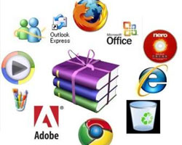
Application Software
It is a set of one or more programs designed to carry out operations for a specific application. Application software cannot run on itself but is dependent on system software to execute.
Example:
Payroll systems, Inventory Control,
Word Processor, Spreadsheet
and Database Management System etc.,

Slide 12
Open Source Software
Open source software (OSS) is computer software whose source code is available under a license that permits users to use, change, and improve the software, and to redistribute it in modified or unmodified form.
It is often developed in a public, collaborative manner.
Well-known OSS products are Linux, Netscape, Apache, etc.,

Slide 13
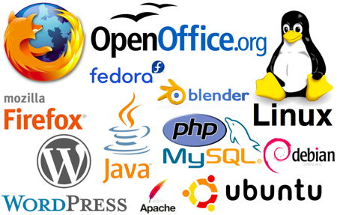
Open Source Software

Slide 14
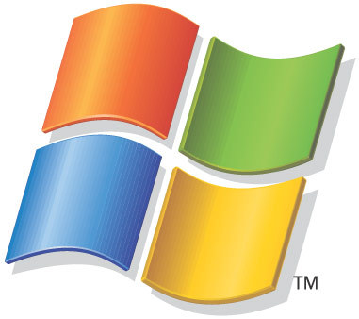
Proprietary Software
Proprietary software (non-free software)
Software with restrictions on using, copying and modifying as enforced by the proprietor. Restrictions on use, modification and copying is achieved by either legal or technical means and sometimes both.
Proponents (advocate) of proprietary software are Microsoft.
Example : MS Office/Windows, CAD, Norton AV etc.,

Slide 15
Proprietary Software
Proprietary software (non-free software)
Software with restrictions on using, copying and modifying as enforced by the proprietor. Restrictions on use, modification and copying is achieved by either legal or technical means and sometimes both.
Proponents (advocate) of proprietary software are Microsoft.
Example : MS Office/Windows, CAD, Norton AV etc.,

Slide 16
Types of System Software
OS Software
Device driver
Utilities

Slide 17
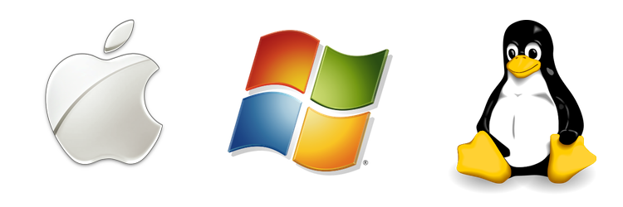
Operating System
An operating system (OS) is software that manages computer hardware and software resources and provides common services for computer programs.
Various characteristics of OS are described as

Slide 18
Operating System
Operating systems perform basic tasks, such as recognizing input from the keyboard, sending output to the display screen, keeping track of files and directories on the disk, and controlling peripheral devices such as disk drives and printers

Slide 19
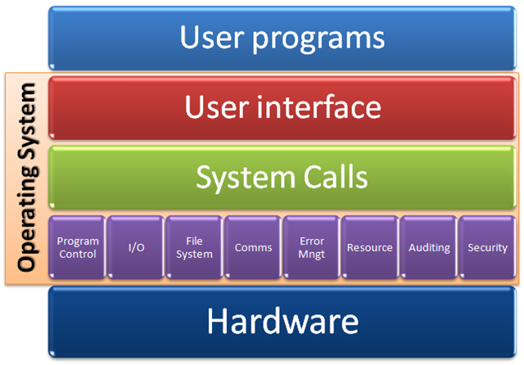
OS
Notes:
A firewall acts as a gatekeeper. It monitors attempts to gain access to your operating system and blocks unwanted traffic or unrecognized sources. ... A firewall acts as a barrier or filter between your computer and another network such as the internet

Slide 20
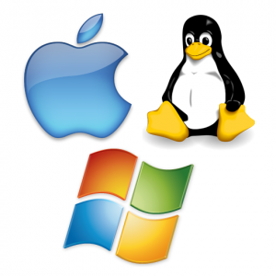
Functions of Operating Systems
Provide a user interface
Run programs
Manage hardware devices
Organized file storage
Memory management
Notes:
Teaching Tip
File and folder storage is covered in chapter 6.

Slide 21
Characteristics of Operating systems
Multi-user
Allows two or more users to run programs at the same time. Some operating systems permit hundreds or even thousands of concurrent users
Multi-tasking
Allows a user to perform more than one computer task at a time.

Slide 22

MULTI TASKING
There are two types of multitasking:
Preemptive multitasking. In preemptive multitasking, the operating system decides how to allocate CPU time slices to each program. ...
Cooperative multitasking. In cooperative multitasking, each program controls how much CPU time it needs.

Slide 23
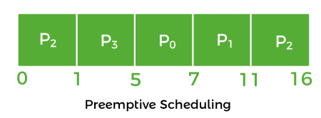
PREEMTIVE MULTI TASKING
Let us take the example of Preemptive Scheduling. We have taken P0, P1, P2, and P3 are the four processes.
Process | Arrival Time | CPU Burst time (in millisec.)
P0 | 3 | 2
P1 | 2 | 4
P2 | 0 | 6
P3 | 1 | 4

Slide 24
PREPRE EMTIVE MULTI TASKING
Firstly, the process P2 comes at time 0. So, the CPU is assigned to process P2.
When process P2 was running, process P3 arrived at time 1, and the remaining time for process P2 (5 ms) is greater than the time needed by process P3 (4 ms). So, the processor is assigned to P3.
When process P3 was running, process P1 came at time 2, and the remaining time for process P3 (3 ms) is less than the time needed by processes P1 (4 ms) and P2 (5 ms). As a result, P3 continues the execution.
When process P3 continues the process, process P0 arrives at time 3. P3's remaining time (2 ms) is equal to P0's necessary time (2 ms). So, process P3 continues the execution.
When process P3 finishes, the CPU is assigned to P0, which has a shorter burst time than the other processes.
After process P0 completes, the CPU is assigned to process P1 and then to process P2.

Slide 25
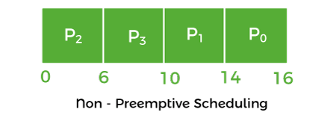
NON PRE EMTIVE MULTI TASKING
Let's take the above preemptive scheduling example and solve it in a non-preemptive manner.
The process P2 comes at 0, so the processor is assigned to process P2 and takes (6 ms) to execute.
All of the processes, P0, P1, and P3, arrive in the ready queue in between. But all processes wait till
process P2 finishes its CPU burst time.
After that, the process that comes after process P2, i.e., P3, is assigned to the CPU until it finishes its burst time.
When process P1 completes its execution, the CPU is given to process P0.

Slide 26
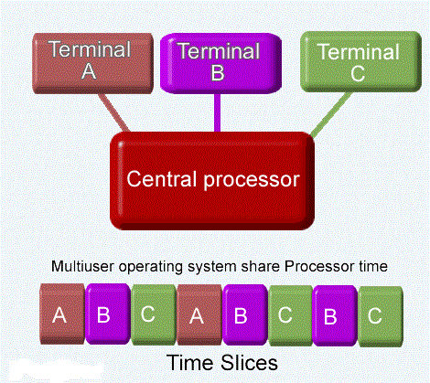
Multi-user / Multi tasking

Slide 27
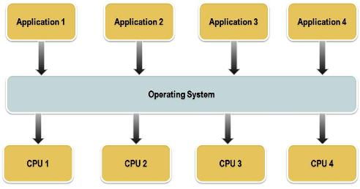
Characteristics of Operating systems
Multiprocessing
Use of two or more central processing units (CPUs) within a single computer system for running a program or application

Slide 28
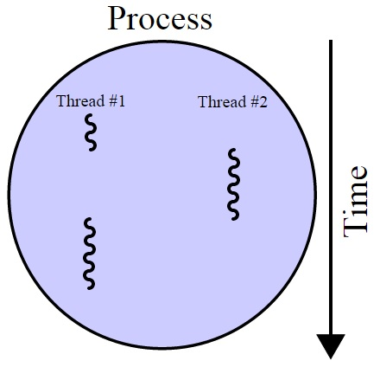
Characteristics of Operating systems
Multithreading
The ability of an operating
system to execute different
parts of a program, called
threads, simultaneously

Slide 29
Characteristics of Operating systems
Real time
A system is said to be Real Time if it is required to complete it’s work & deliver it’s services on time or instantly
Example – Flight Control System
All tasks in that system must execute on time.
Very fast small OS
Built into a device
Respond quickly to user input

Slide 30
Characteristics of Operating systems
Hard Real Time System
Failure to meet deadlines is fatal
example : Flight Control System
Soft Real Time System
Late completion of jobs is undesirable but not fatal
System performance degrades as more & more jobs miss deadlines
Online Databases

Slide 31
Types of Operating Systems
Real-time operating system
A system is said to be Real Time if it is required to complete
it’s work & deliver it’s services on time or instantly
Example – Flight Control System, Medical devices
All tasks in that system must execute on time
Very fast small OS
Built into a device
Respond quickly to user input

Slide 32
Types of Operating Systems
Single user/Single tasking OS
One user works on the system
Performs one task at a time
MS-DOS and Palm OS
Take up little space on disk
Run on inexpensive computers

Slide 33
Types of Operating Systems
Single user/Multitasking OS
User performs many tasks at once
Most common form of OS
Windows XP/7/8 and OS X
Require expensive computers
Tend to be complex
Multi-tasking operating systems are complex
However both XP and OS X make the multitasking process painless
Notes:
Teaching tip
It is true that multi-tasking operating systems are complex. However both XP and OS X make the multitasking process painless for the user.

Slide 34
Types of Operating Systems
Multi user/Multitasking OS
Found on supercomputers, mainframes and minicomputers
Many users connect to one computer
Each user has a unique session
UNIX, Linux, and VMS
Maintenance can be easy
Requires a powerful computer

Slide 35
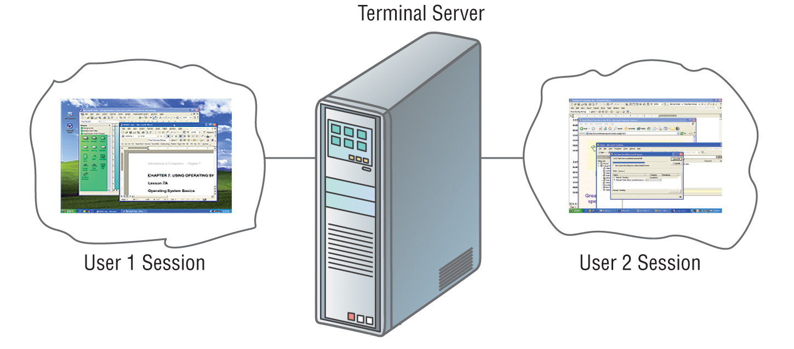
Multi user/Multi tasking OS

Slide 36
Classification of Operating systems
Multi-user: Allows two or more users to run programs at the same time. Some operating systems permit hundreds or even thousands of concurrent users.
Multiprocessing : Supports running a program on more than one CPU.
Multitasking : Allows more than one program to run concurrently.
Multithreading : Allows different parts of a single program to run concurrently.
Real time: Responds to input instantly.

Slide 37
Device Driver
A device driver (commonly referred to as simply a driver) is a computer program that operates or controls a particular type of device that is attached to a computer.
Examples Mouse driver, keyboard driver, video card driver, sound card driver

Slide 38
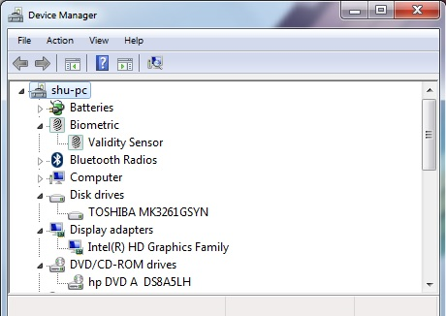
Device Driver

Slide 39
THANKYOU
☺

